Slide 1
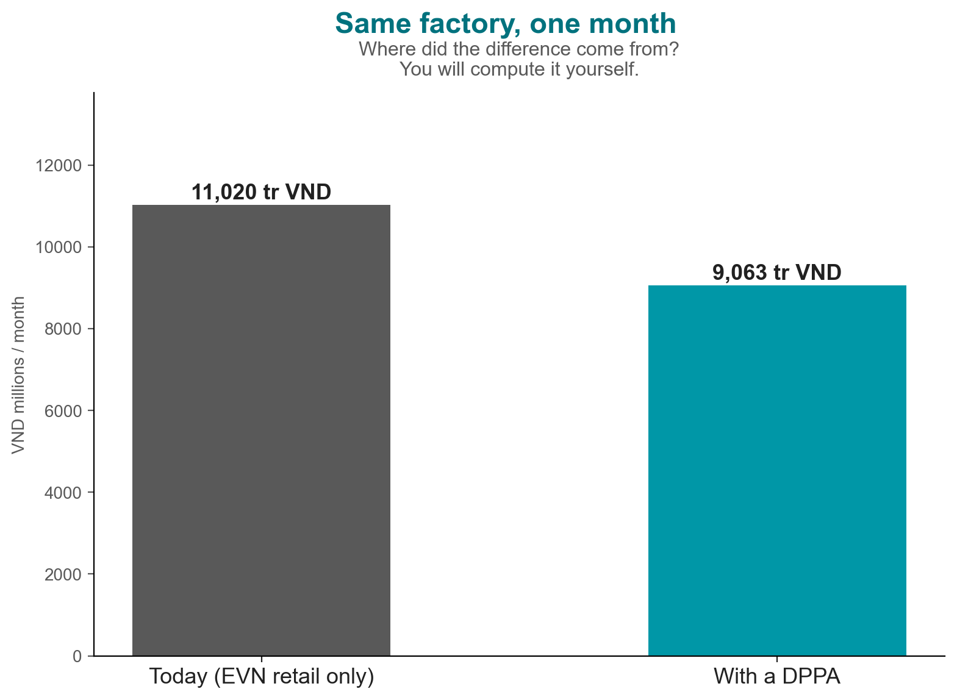
Song Hong Garment Co.: one month, two bills
Today: 11,020 tr VND. With a DPPA: 9,063 tr VND. Where did the gap come from? You will compute it.
Notes:
COLD OPEN (2 min). Show the two bars. Do not explain the gap yet — that is the session's promise. Hook line: 'In 60 minutes you will compute every line of that difference yourself.' Breadcrumb strip introduced next as the roadmap.

Slide 2
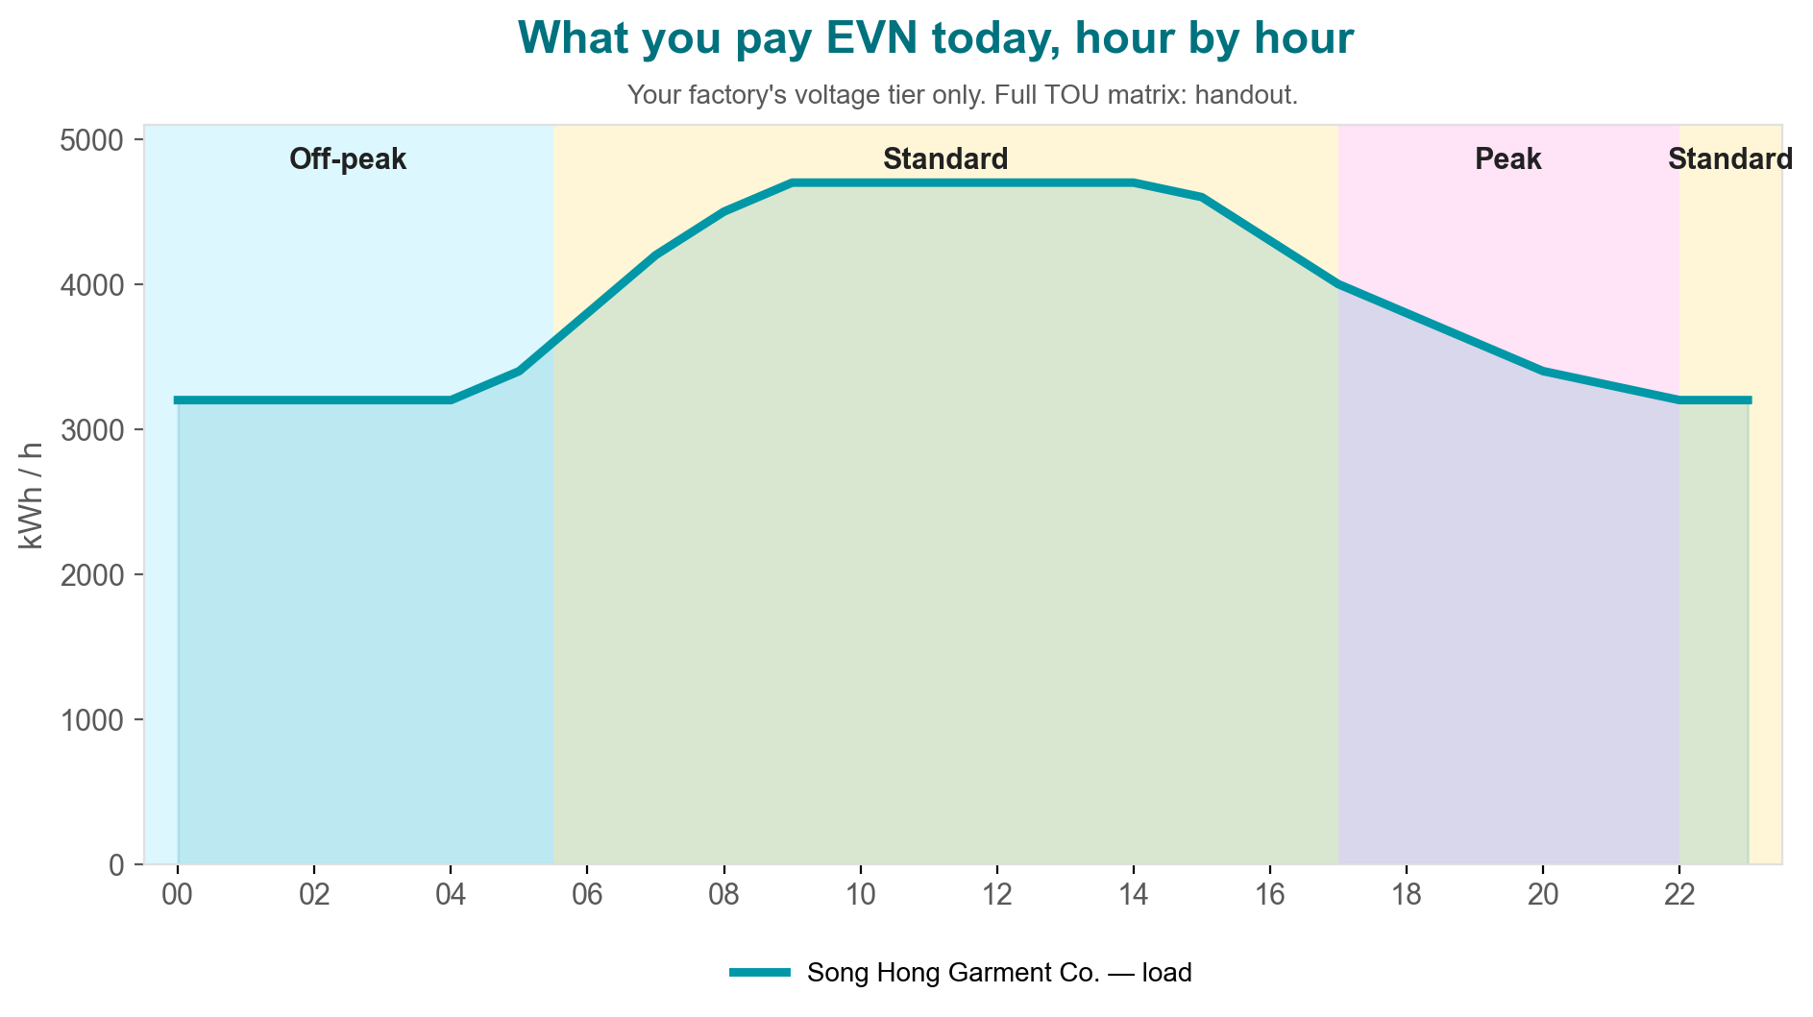
What you pay EVN today
Song Hong Garment Co. — hour by hour, before any DPPA. This is the bill every DPPA offer is judged against.
Notes:
M1 (4 min). Point at the TOU bands, then the load line. State: 'This is BAU — every DPPA offer is judged against this.' App moment: none for M1 (visual only).

Slide 3
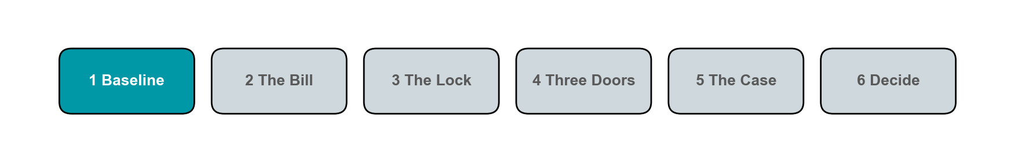
1. The Baseline
Notes:
CHECKPOINT (30 sec, show of hands): If load rises in the evening peak, does your bill rise faster or slower than at noon? Do not move on until at least half the room answers.

Slide 4
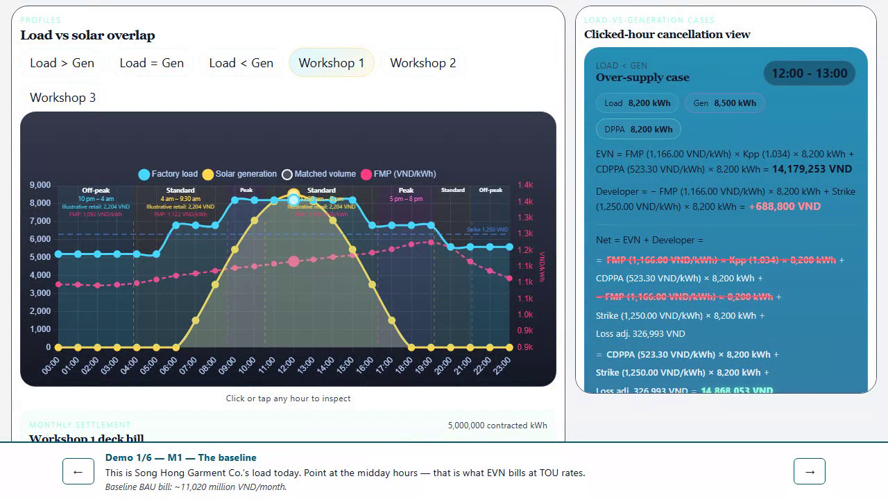
[Fallback — Module 1 app demo]
Notes:
HIDDEN FALLBACK SLIDE. Unhide and play only if the live app fails for the module 1 demo. Also runnable locally via `npm run preview` in app/ if venue wifi is down.

Slide 5
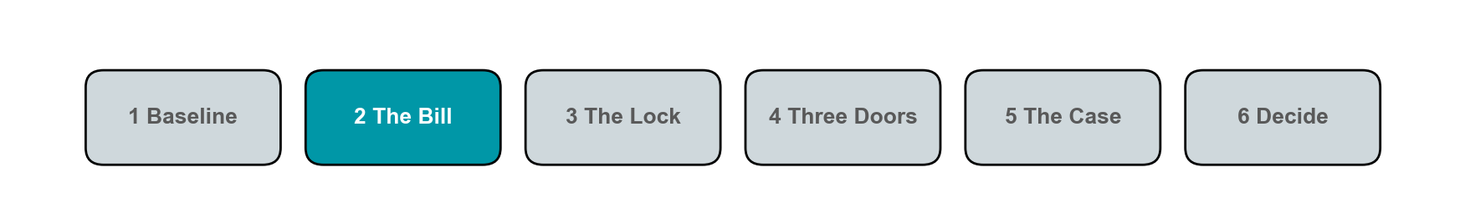
2. The Bill
Notes:
CHECKPOINT (30 sec, show of hands): Which of the five lines disappears when consumption exactly equals matched volume? Do not move on until at least half the room answers.

Slide 6
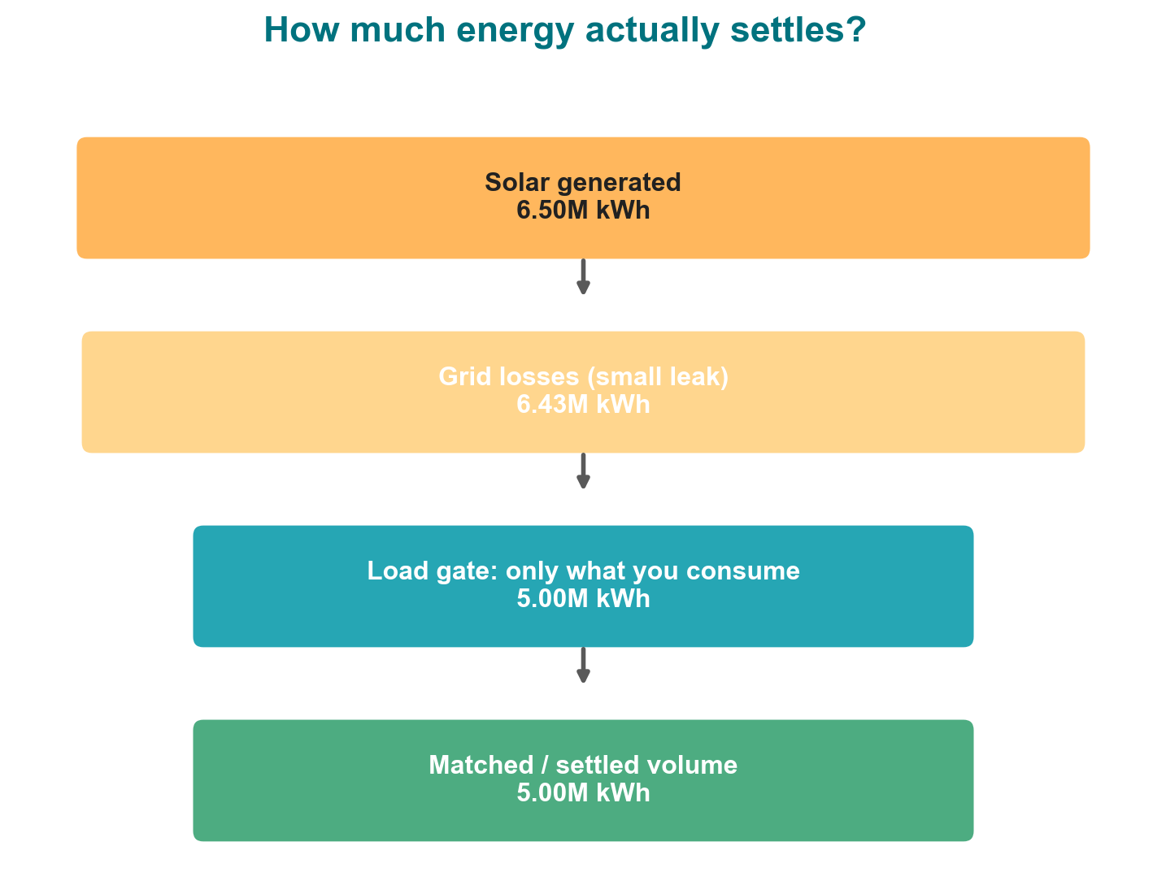
How much energy actually settles?
Generation leaks a little, then passes a load gate and a contract gate. Only what survives both gates settles.
Notes:
M2a (2 min). Walk the funnel top to bottom: generation, loss leak, load gate, contract gate. No formulas — 'you only settle what survives both gates.'

Slide 7
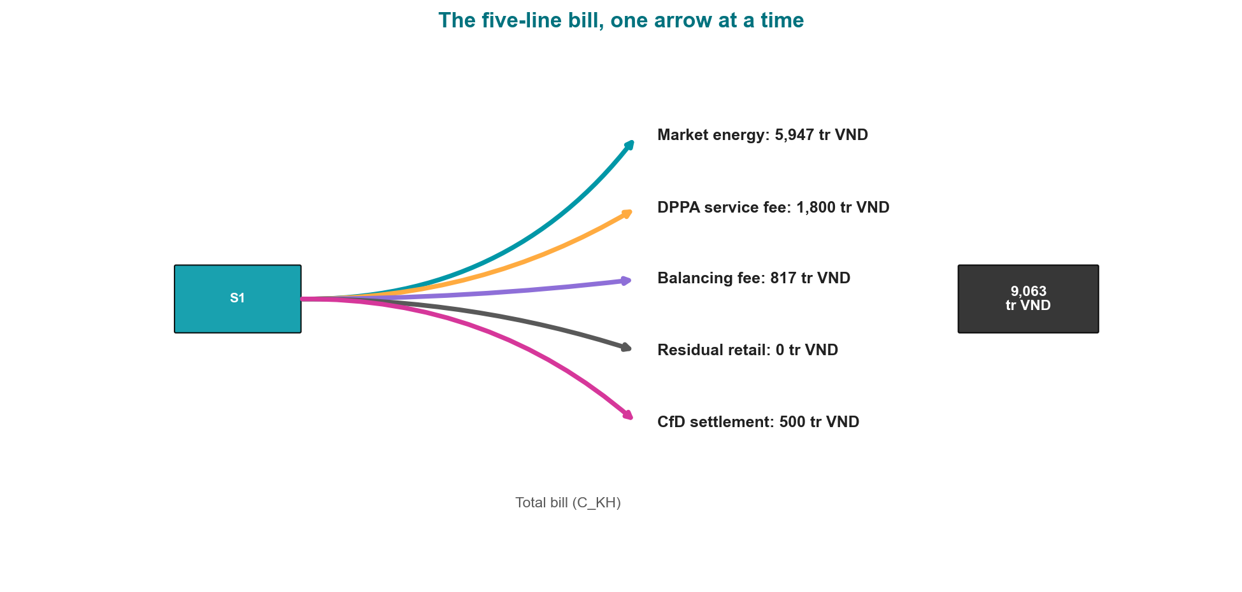
The five-line bill, one arrow at a time
Market energy 5,947 + fees 2,617 + CfD 500 = 9,063 tr VND.
Notes:
M2b (3 min). Play m2-sankey-build-en.gif in slideshow mode (autoplay). Read each arrow aloud as it appears. APP MOMENT: switch to the live app, scroll to the five-line-bill panel, confirm the same numbers (C_EVN 8,563, CfD 500, C_KH 9,063 tr VND).

Slide 8
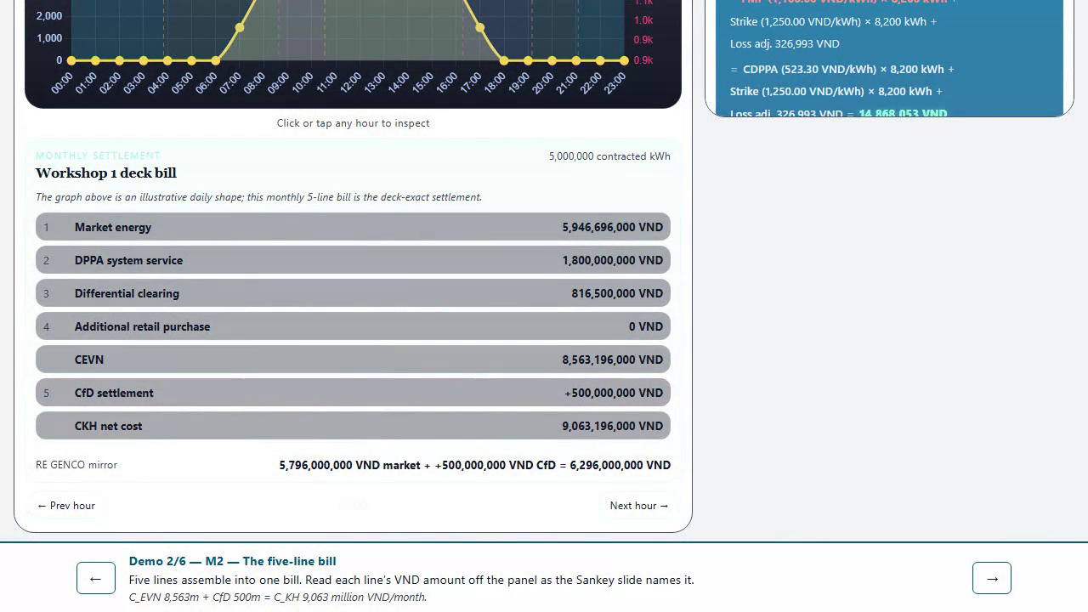
[Fallback — Module 2 app demo]
Notes:
HIDDEN FALLBACK SLIDE. Unhide and play only if the live app fails for the module 2 demo. Also runnable locally via `npm run preview` in app/ if venue wifi is down.

Slide 9
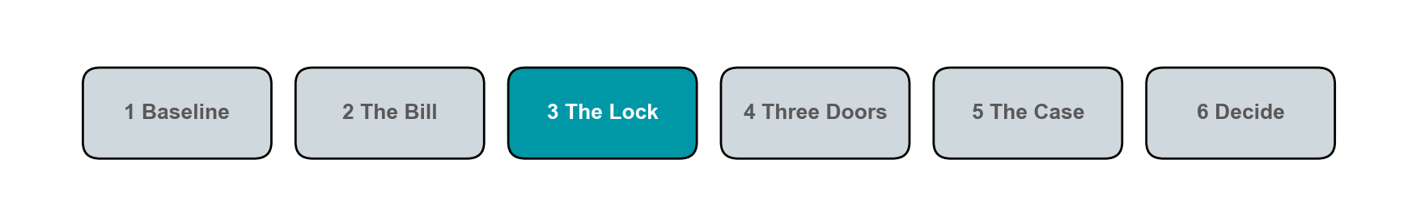
3. The Lock
Notes:
CHECKPOINT (30 sec, show of hands): If the market price jumps above the strike mid-afternoon, who pays whom? Do not move on until at least half the room answers.

Slide 10
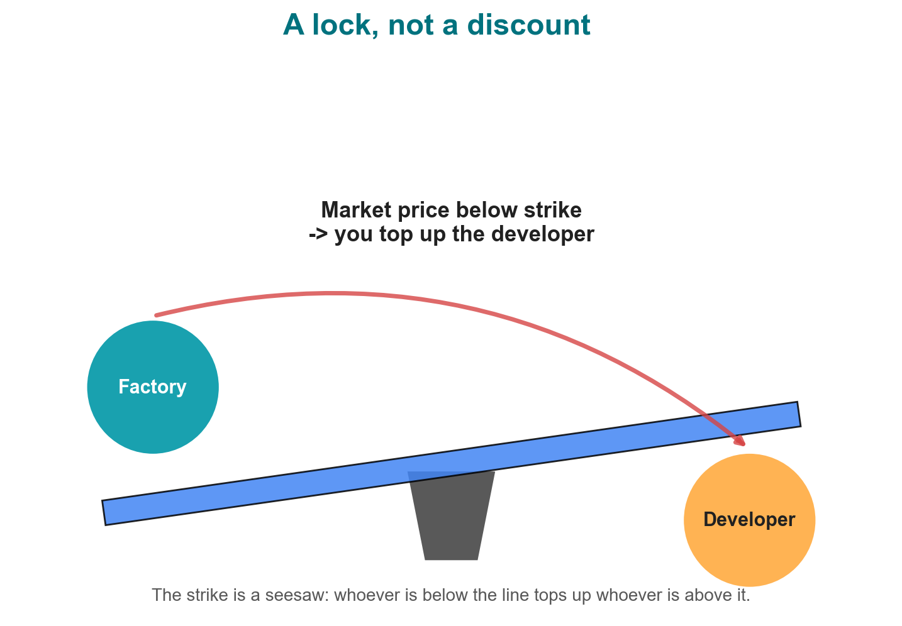
A lock, not a discount
The strike is a seesaw. Below it, you top up the developer. Above it, the developer pays you.
Notes:
M3 (4 min). Show the seesaw, then play assets/cfd-s1-en.gif for the 24h sign flip. App moment: drag the market-price slider through the strike and watch the CfD line flip sign.

Slide 11
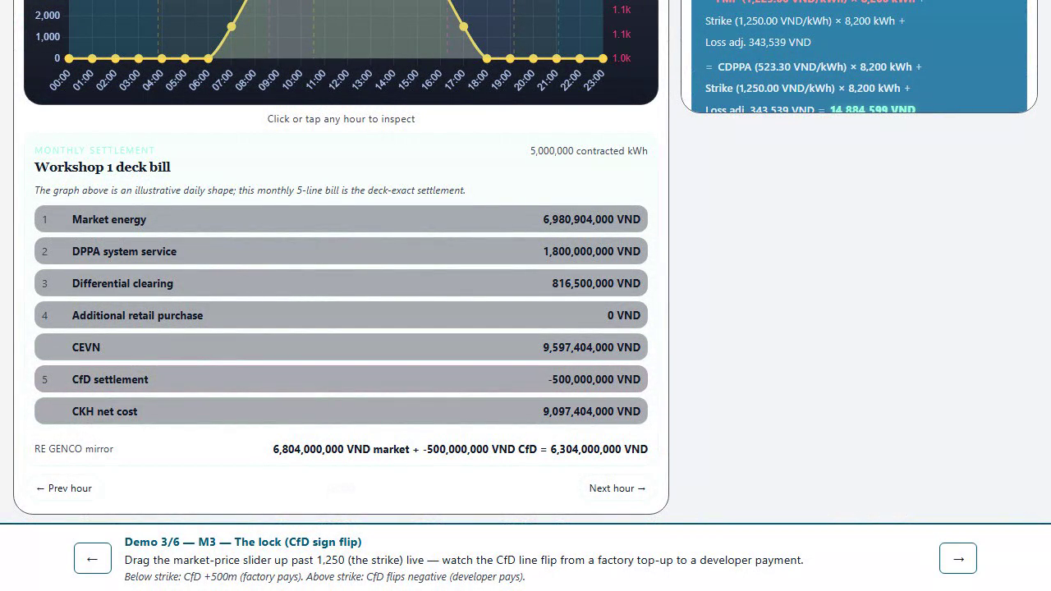
[Fallback — Module 3 app demo]
Notes:
HIDDEN FALLBACK SLIDE. Unhide and play only if the live app fails for the module 3 demo. Also runnable locally via `npm run preview` in app/ if venue wifi is down.

Slide 12
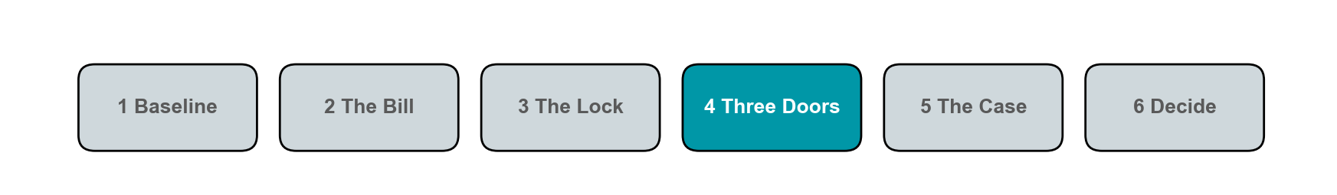
4. Three Doors
Notes:
CHECKPOINT (30 sec, show of hands): Which of the three doors is hardest to pass when the strike is set too high? Do not move on until at least half the room answers.

Slide 13
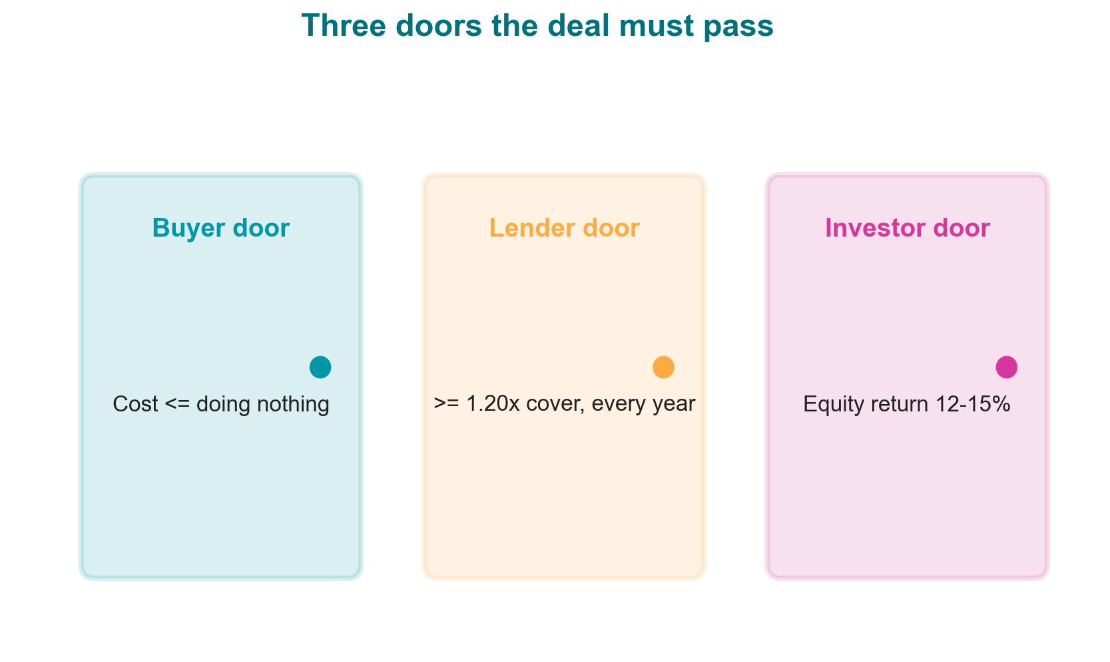
Three doors the deal must pass
Buyer: cost below doing nothing. Lender: covered every year. Investor: return earned. All three, or no deal.
Notes:
M4 (4 min). Name each door once, no ratio math on-slide. APP MOMENT: multi-year panel, point at the crossover year as the buyer-door check.

Slide 14
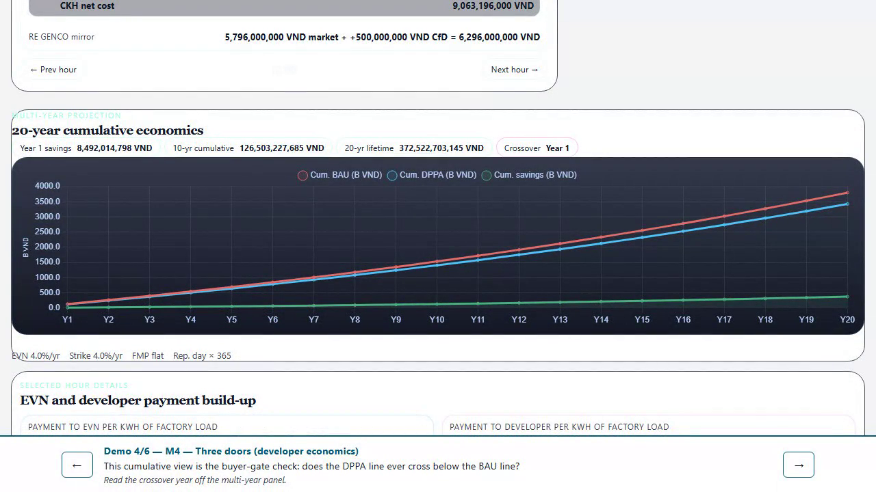
[Fallback — Module 4 app demo]
Notes:
HIDDEN FALLBACK SLIDE. Unhide and play only if the live app fails for the module 4 demo. Also runnable locally via `npm run preview` in app/ if venue wifi is down.

Slide 15
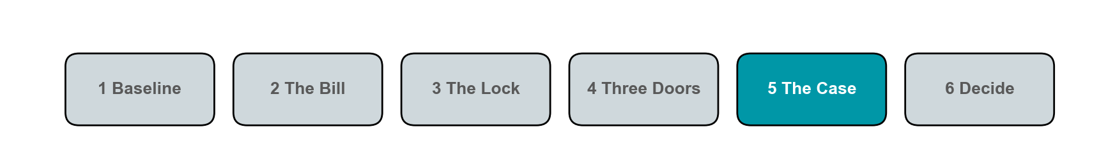
5. The Case
Notes:
CHECKPOINT (30 sec, show of hands): In the 70-scenario sweep, how many pass all three gates at once? Do not move on until at least half the room answers.

Slide 16
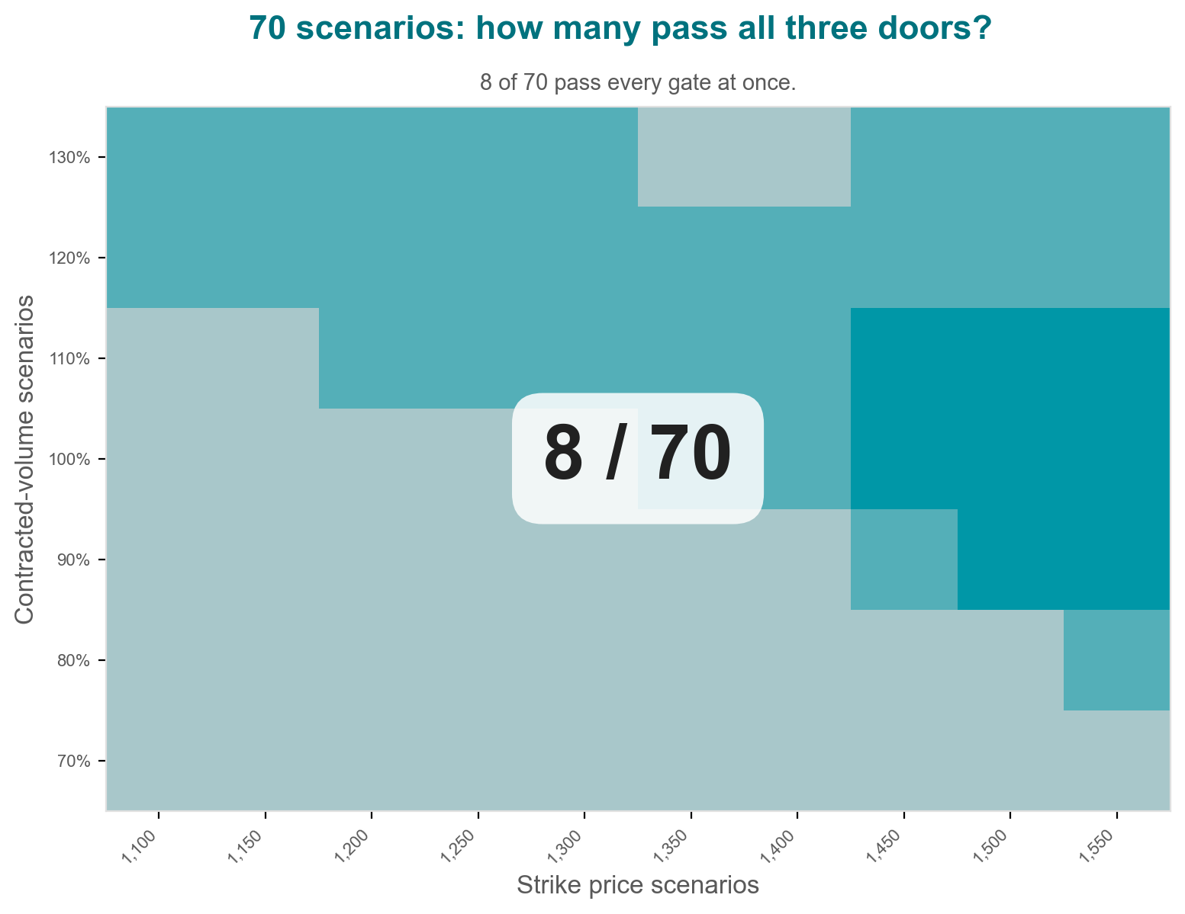
70 scenarios, how many clear the window
Sweep strike x volume across both case studies: 8 of 70 combinations clear all three doors at once.
Notes:
M5 setup (2 min). Do NOT reveal the heatmap takeaway yet — that comes after the exercise.

Slide 17
Your turn: compute the bill
Worksheet: Song Hong Garment Co., S1. Volumes are pre-filled. Compute all five lines in VND millions, total, and compare to the BAU bar from the cold open. 10 minutes.
Notes:
M5 EXERCISE (10 min, the session's success criterion). Hand out the one-page worksheet (lessons/0012-reference-card). Volumes pre-filled: contracted=total=5,000,000 kWh. Answer key: marketEnergy 5,947, service 1,800, clearing 817, residual 0, CfD 500, total 9,063 tr VND. APP MOMENT: verify against the five-line-bill panel.

Slide 18
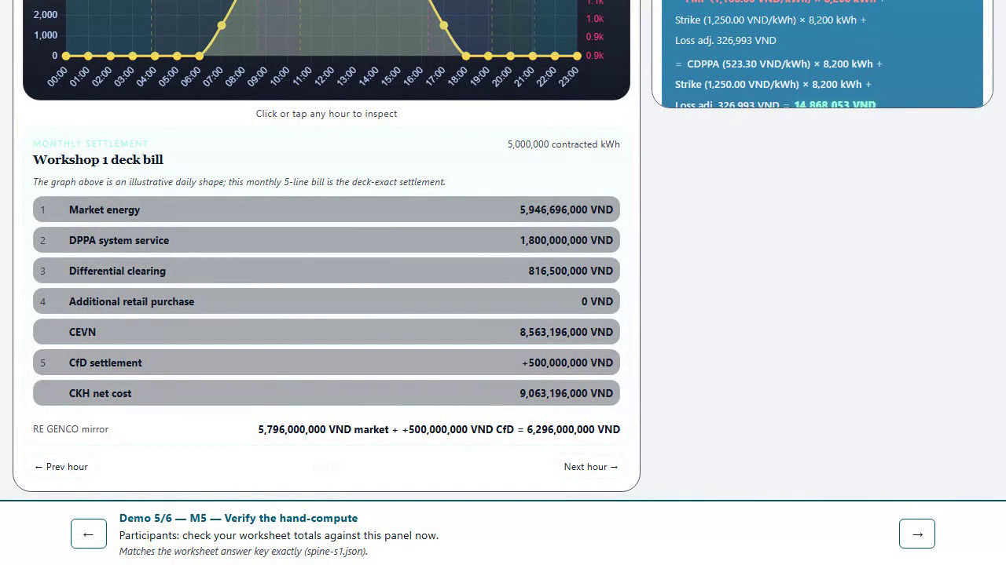
[Fallback — Module 5 app demo]
Notes:
HIDDEN FALLBACK SLIDE. Unhide and play only if the live app fails for the module 5 demo. Also runnable locally via `npm run preview` in app/ if venue wifi is down.

Slide 19
The window, revealed
Now scale your month x12 x20 strikes: 8 of 70 pass all three doors.
Notes:
M5 REVEAL (2 min). This is the punchline: the exercise they just did, multiplied across a lifetime and a strike sweep, is why only 8 of 70 combinations clear every gate in these two case studies. Per-gate breakdown: buyer 62, lender 36, investor 15 -- see which gate actually binds. CAVEAT if asked: the lender and investor gates are illustrative two-dimensional proxies (a contracted-revenue DSCR test and a blended-revenue LCOE test), not modelled debt schedules or equity IRR -- settlement.js is buyer-side only. The buyer gate is the exact lifetime-cost comparison; treat lender/investor as illustrative until H3 (real Allotrope deal data) lands.

Slide 20
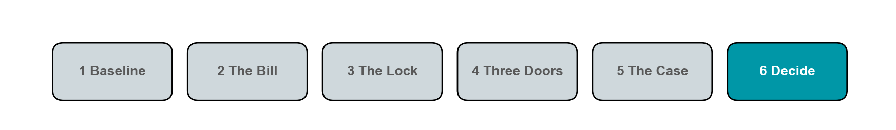
6. Decide
Notes:
CHECKPOINT (30 sec, show of hands): Name one lever that would have flipped this month's CfD sign. Do not move on until at least half the room answers.

Slide 21
Decoder: your words, the decree's symbols
Matched / settled volume
Q_khc
Total consumption
Q_KH
Market price
FMP
Locked price
Strike / P_c
Total bill
C_KH = C_EVN + C_CfD
Notes:
This is the ONLY slide with Decree-57 notation. Frame it as translation, not new content: 'you already understand every row on the left — the right column is what the legal text calls it.' Full formula appendix (old slide 27) is in the printed A4 card, not here.

Slide 22
Five levers you can still negotiate
Strike price: Lower strike -> lower CfD cost when FMP is below strike
Contracted volume (Q_c): Match Q_c to real consumption to avoid excess/shortfall risk
Tenor / escalation: Longer lock trades flexibility for price certainty
Settlement mode: Matched-only vs generation vs allocated changes who bears volume risk
Termination / step-out terms: Determines the cost of exiting if the deal stops passing the three gates
Notes:
Walk each lever in ~15 seconds: name it, say which way it moves the bill. This is the checklist they take into their next term-sheet negotiation.

Slide 23
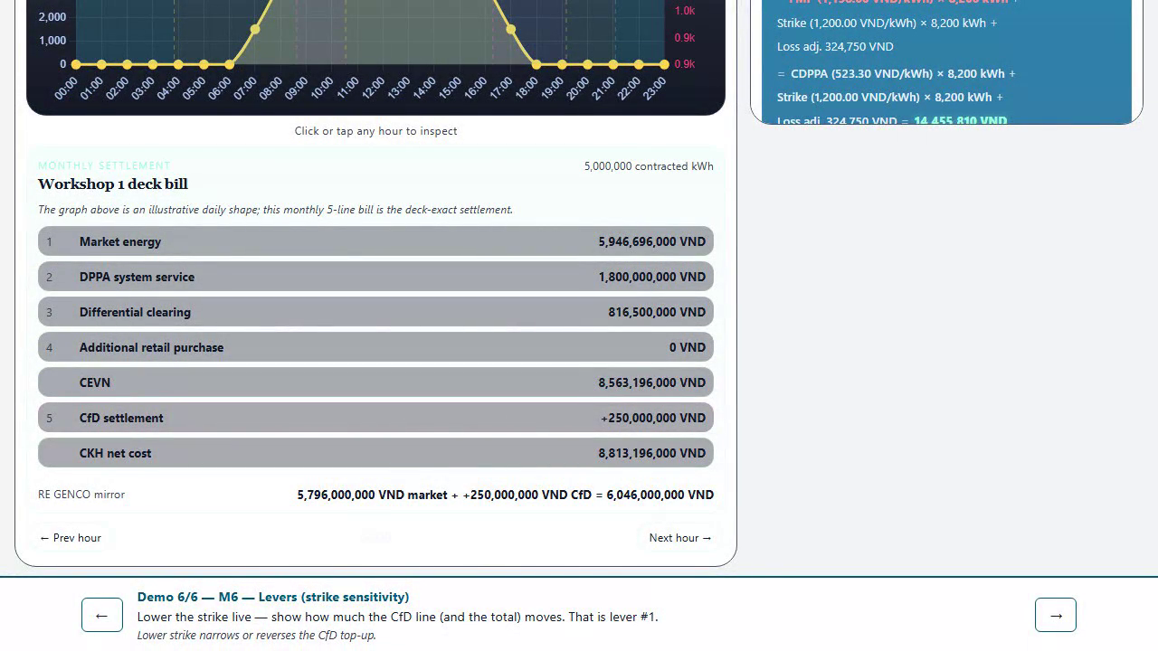
[Fallback — Module 6 app demo]
Notes:
HIDDEN FALLBACK SLIDE. Unhide and play only if the live app fails for the module 6 demo. Also runnable locally via `npm run preview` in app/ if venue wifi is down.

Slide 24

You can now compute every line of this bill
Scan: dppa-case.web.app
Bring the five levers to your next term sheet. Scan for the app, lessons, and the 90-min scenario workshop.
Notes:
CLOSE (2 min). Point back at the cold-open bars. Invite to the 90-min scenario workshop for negotiation practice. QR: dppa-case.web.app and lessons index.

Slide 25
Scenario 1 — Matched
Consumption equals matched volume. No residual retail line.
Notes:
Appendix slide, slimmed per DEC-021. Play the animated chart; state the one-line takeaway. Detailed numbers live in the scenario lessons/worksheets, not here.

Slide 26
Scenario 2 — Shortfall
Consumption exceeds contract. The residual buys back at retail — always the expensive line.
Notes:
Appendix slide, slimmed per DEC-021. Play the animated chart; state the one-line takeaway. Detailed numbers live in the scenario lessons/worksheets, not here.

Slide 27
Scenario 3 — Excess
Generation exceeds consumption. The excess earns spot revenue only — no CfD, no free upside.
Notes:
Appendix slide, slimmed per DEC-021. Play the animated chart; state the one-line takeaway. Detailed numbers live in the scenario lessons/worksheets, not here.

